Slide 1
Fixing Broken Windows:
Code→Team→You
Dmitry Vinnik, @DmitryVinnik
Lead Software Engineer, Salesforce

Slide 2
Today’s Focus
What is our focus today?
Legacy Systems:
What, Why, How and When
Union of Engineering and Quality
Beyond Code - Team & You
Notes:
Design perspective, not testing DDD application

Slide 3
What goes into Building Software?

Slide 4
Building Software
Building Software
Code
Team
Individuals

Slide 5
Human component is essential!
Conclusion?
So, let’s make it personal

Slide 6
Instead of
Building Software
Building Your Software
Notes:
Note: Building = Testing, don`t ever forget that -> Testers are an integral part of any software team

Slide 7
Building Software
Building Software
Your Code
Your Team
You

Slide 8
3 elements
How many elements is that?
Notes:
Your Code
Your Team
You

Slide 9
What can go wrong, right?

Slide 10
Let’s step back
But
Before going further

Slide 11
Remember the Title?
What are those Broken Windows?
Fixing Broken Windows

Slide 12
Broken Windows Theory

Slide 13

Source: Pixabay
Notes:
Define Theory: criminological theory that visible signs of crime, anti-social behavior, and civil disorder create an urban environment that encourages further crime and disorder, including serious crimes. The theory thus suggests that policing methods that target minor crimes such as vandalism, public drinking, and fare evasion help to create an atmosphere of order and lawfulness, thereby preventing more serious crimes.
Example: Throwing a wrapper on the streets (and not throwing on the clean streat) -> clean bengalore story
Reference: https://pixabay.com/en/broken-window-shot-building-409496/

Slide 14
Why does it matter?

Slide 15
Broken Windows
Broken Software

Slide 16
Broken Software
Broken Software
Broken Code
Broken Team
Broken You
Notes:
Can have little cracks at every level, which will ultimately break your code, your team and you -> Broken Software

Slide 17
Broken Software
and
its Elements
Focus for today

Slide 18
Fixing Broken “Windows” of Software

Slide 19
Agenda
Agenda
Broken Code
Broken Team
Broken Team
Broken You
Broken You
Notes:
Remember - human component is essential
Hence, start with purely technical aspect, code

Slide 20
Number 1
Software Grievance?
Legacy Systems

Slide 21
“Legacy code is simply code without tests.”
by Michael Feathers

Slide 22
What if we wanted to add more tests?
Catch 22
Notes:
But again, catch 22 - 1. when we don`t have tests, it is easy to make unintentional errors when we change code
Definition of catch 22 - you are not insane if you can request evaluation for insanity

Slide 23
To Add
Tests
Need to Refactor
To
Refactor
Need to Add Tests

Slide 24
Why can’t we just
add tests?
Need to preserve Behavior
Notes:
Focus on “Just” - One of the most dangerous words

Slide 25
Main Focus in Software
Features
Behavior
Requirements
Live Product
Notes:
Don`t make changes for the sake of changes
Preserving behavior is essential
Old bug is a part of the requirements now

Slide 26
Conclusion?
Customers care
about Behavior first

Slide 27
So do we just leave it?
Maybe

Slide 28
Always Keep In Mind
Cost of Transition
ROI
Popularity Contest
Nothing as Option
Notes:
If it is not broken, don`t fix it
Note: common problem - fitting solution to a non-existent problem (ex. Refactoring monolith into microservices; or moving from Selenium to Cypress.io)
Nothing as an option should always be on the table

Slide 29
What if we want to change code?
What does it mean, Change Code?

Slide 30
Changing Code
New Features
Bug Fixes
Design Changes
Optimization
Notes:
Definition according to Michael Feather
Brand new functionalities
Fixing bugs
Improving design
Optimization
Remember the danger of early optimization

Slide 31
If you are changing Legacy System
Take time to change its Legacy Status
Notes:
All those reasons for changing code, review its legacy status
Easier to justify - you are already in the code
Example, legacy tests
If they are failing, you might as well fix and refactor the area
If they are not failing, there is no problem in the first place

Slide 32
Main Rules of Legacy
Chia Pet Pattern
Glued Pattern
Best
Single Goal Changes
Better
Notes:
Do not add to already broken system - delegate new functionality, abstract it, and only change that
Avoid creating more dependencies by using anti-patterns such as singleton to introduce more connection between elements
Keep your changes focus
Personal, creating multiple changes lists at once
Multitasking is overrated
Better is always more desirable than Best (or nothing in most cases)
Example, Obama welcoming interns in the Whitehouse and his recollection of compromises around Affordable Care Act

Slide 33
General Guidance
Seams
Unit of Behavior
SOLID
Patterns
Toolbox
Notes:
Seam - is place in the code where you can change the behavior of your program without modifying the code itself
Want to focus on working with them
Enables to separate code under test
Enables to sense the behavior of the code under test
SOLID Patterns (source, https://scotch.io/bar-talk/s-o-l-i-d-the-first-five-principles-of-object-oriented-design)
S - Single-responsibility principle
O - Open-closed principle
open for extension, but closed for modification.
L - Liskov substitution principle
I - Interface segregation principle
should never be forced to implement an interface that it doesn't use
D - Dependency Inversion Principle
Toolbox
IDE - helps with refactoring
Comiler - finds checked exceptions

Slide 34
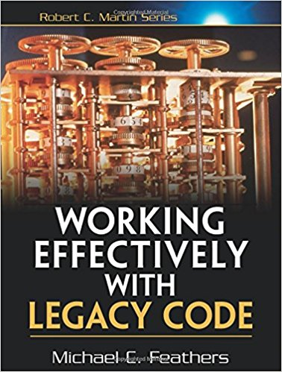
Book Suggestion
Notes:
Reference: https://www.amazon.com/FEATHERS-WORK-EFFECT-LEG-CODE/dp/0131177052

Slide 35
What if it is not Legacy?
Same general rules
And then some

Slide 36
Code Smells
Broken Windows
Notes:
Often referred to as Code Smells -> same thing as Broken Windows of our software
Will use practices from Code Smells to deal with Broken Windows

Slide 37
Ground for Code Smells
Ground for Code Cracks
Duplicate Code
Length Rules
YAGNI Violations
Comments
Notes:
Cracks in the code as cracks in the windows -> precursor to the major breakage
Mentioned but will reiterate

Slide 38
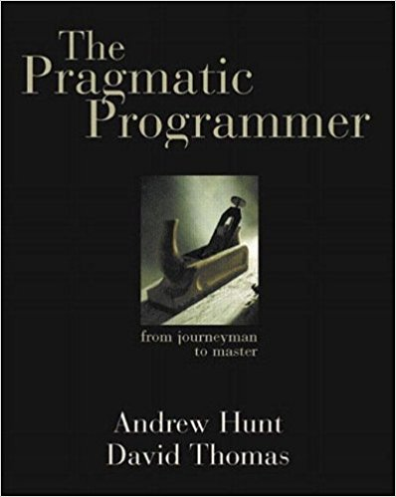
Book Suggestion
Notes:
Reference: https://www.amazon.com/Pragmatic-Programmer-Journeyman-Master/

Slide 39
Refactoring Guidance
Field Control
Data Control
Design by Contract
Notes:
In addition to what was mentioned
Field Control
Rule of the least privilege
Fields -> private,
Fewer fields
Design for Concurrency
More immutable
Data Control
Data Objects -> collections
Accessing collection directly, modfying it
Violating Query/Command (non-mutator/mutator) rules
Conditionals and Object States
Optionals
Temporary values
Back to point of Better > Best
Readability over design, sometimes

Slide 40
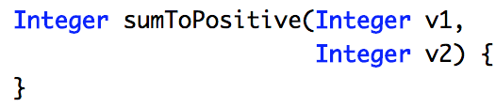
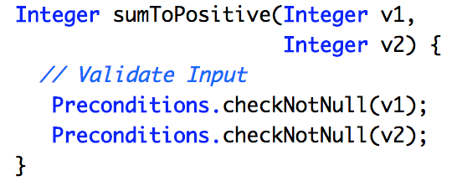
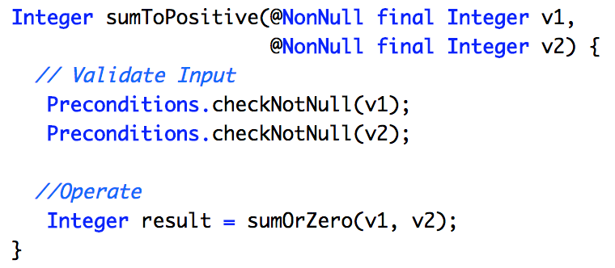
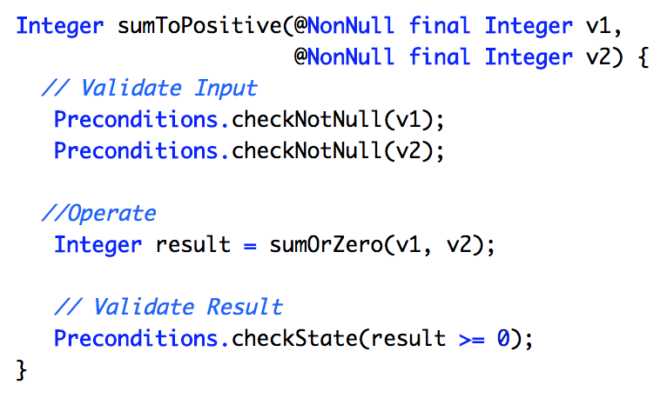
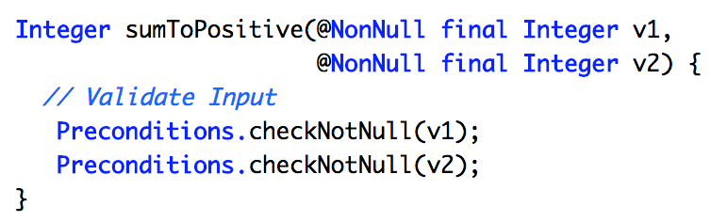
“Require No More,
Promise No Less”
Design by Contract
Design Guidance:
Design by Contract
Quote from Bertrand Meyer, “Design by Contract”

Slide 41
Refactoring Guidance
Field Control
Data Control
Design by Contract
Conditions
& States
Notes:
In addition to what was mentioned
Field Control
Rule of the least privilege
Fields -> private,
Fewer fields
Design for Concurrency
More immutable
Data Control
Data Objects -> collections
Accessing collection directly, modfying it
Violating Query/Command (non-mutator/mutator) rules
Conditionals and Object States
Optionals
Temporary values
Back to point of Better > Best
Readability over design, sometimes

Slide 42
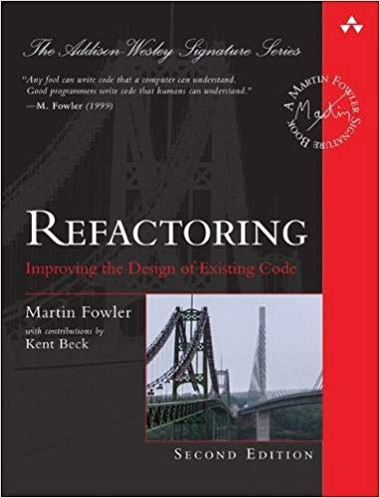
Book Suggestion
Notes:
Reference: https://www.amazon.com/Refactoring-Improving-Existing-Addison-Wesley-Signature/dp/0134757599

Slide 43
That’s all great
We know Refactoring techniques
We know when to use them

Slide 44
Through tests, of course!
How do we preserve the Behavior?

Slide 45
Characterization Tests
Behavior Driven
↑ Confidence
Notes:
According to michael Feather
1. The first tests that you write for a class you are changing
. 2. These tests characterize existing behavior.
3. They hold it down like a vise when you are 4. working

Slide 46
Characterization Tests
Domain Driven Tests

Slide 47
Domain Driven Tests
Based on Principles of Domain Driven Design
Notes:
Encourage them to watch my Domain Driven Testing talk

Slide 48
Domain Driven Design
Know Your Domain
Dogfooding
Respecting Boundaries
Communication is Key

Slide 49
Is DDD useful in tests?
Of course!
Domain Driven
Test Pyramid

Slide 50
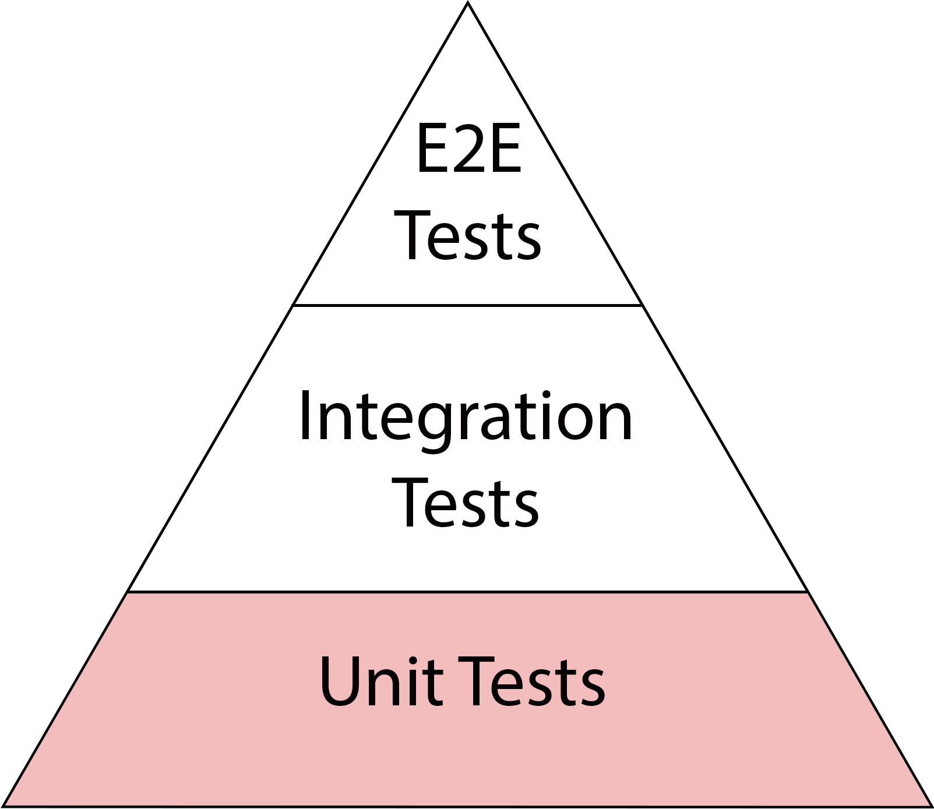
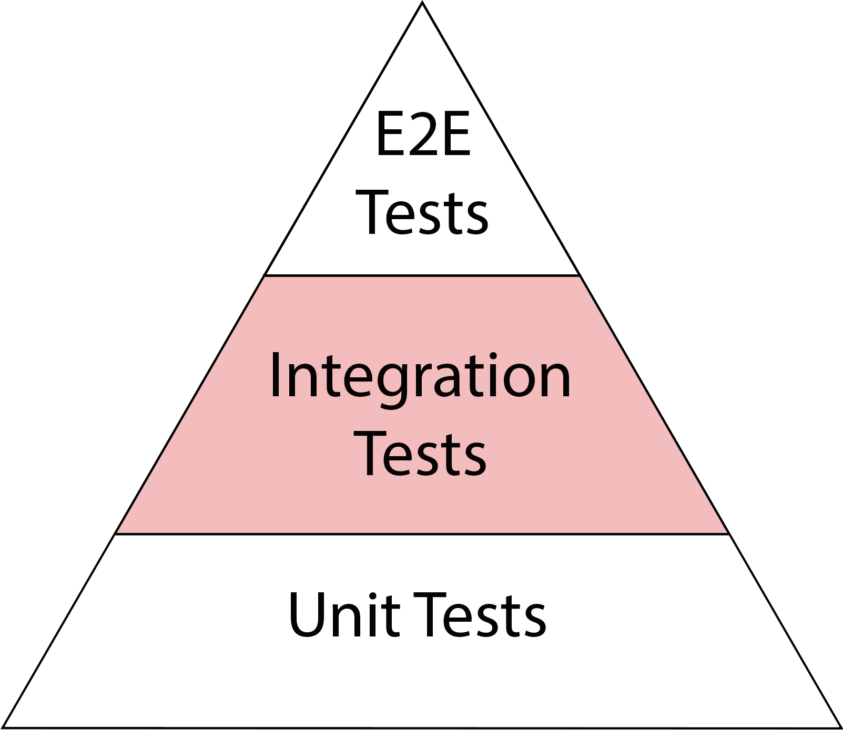
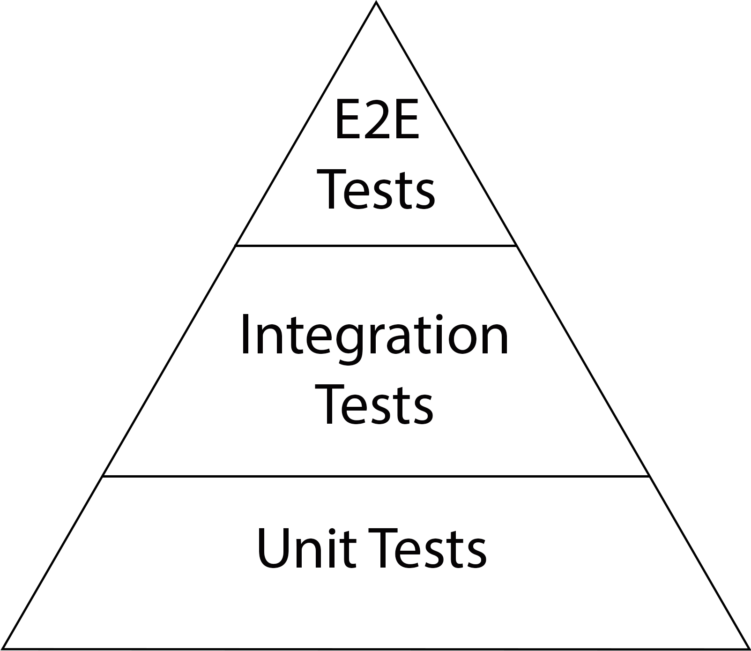
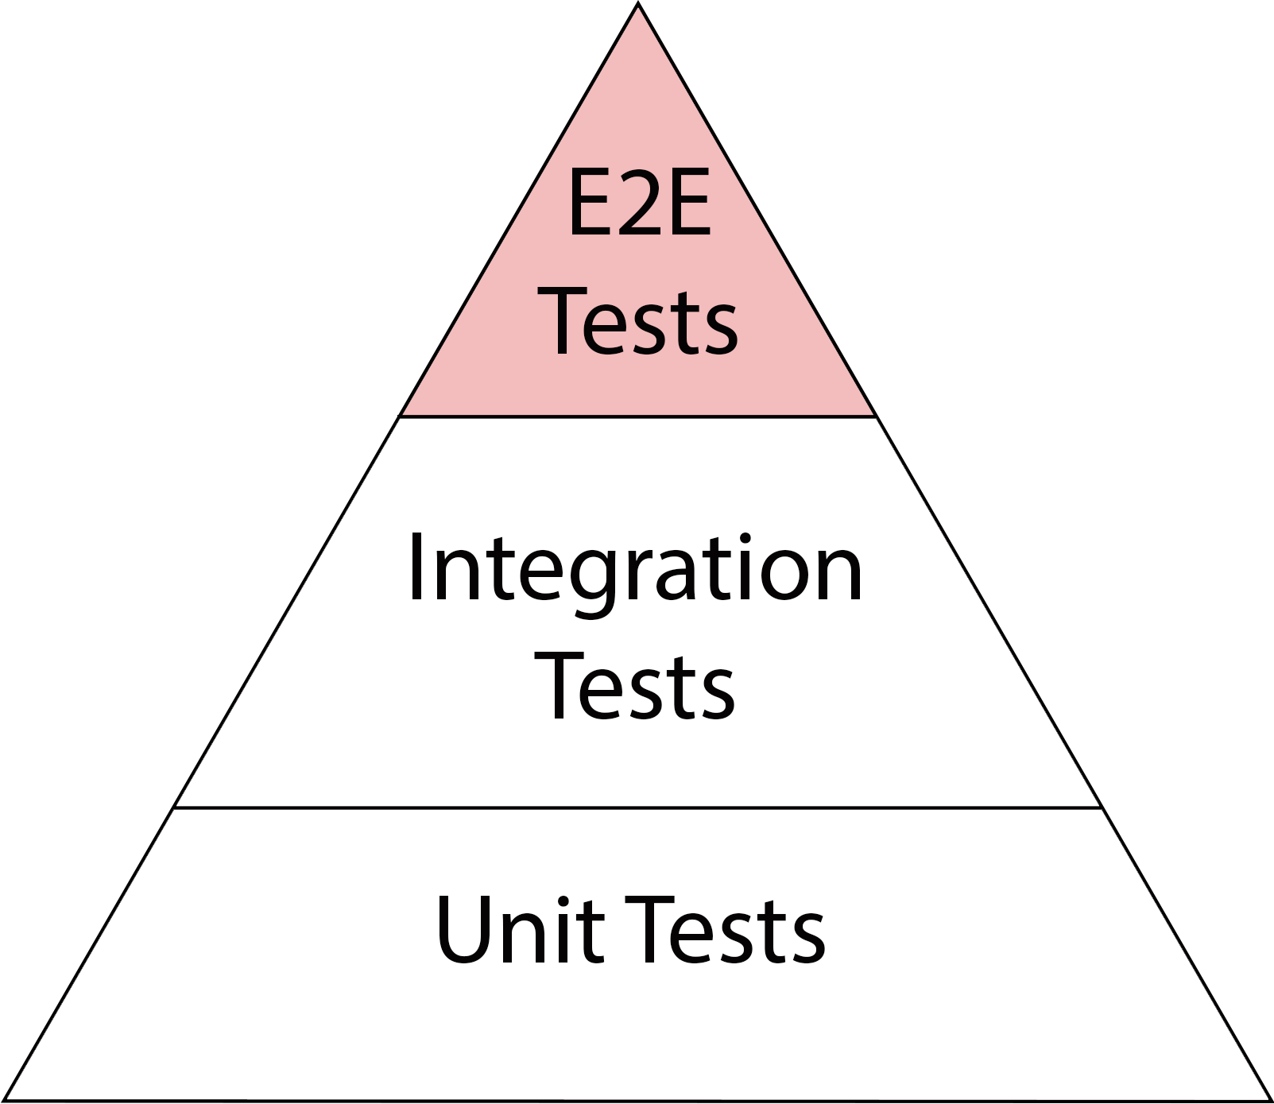
Test Pyramid
↑ Fidelity
↓ Speed
↑ Cost
↓ Fidelity
↑ Speed
↓ Cost
Notes:
Explain width is #tests

Slide 51
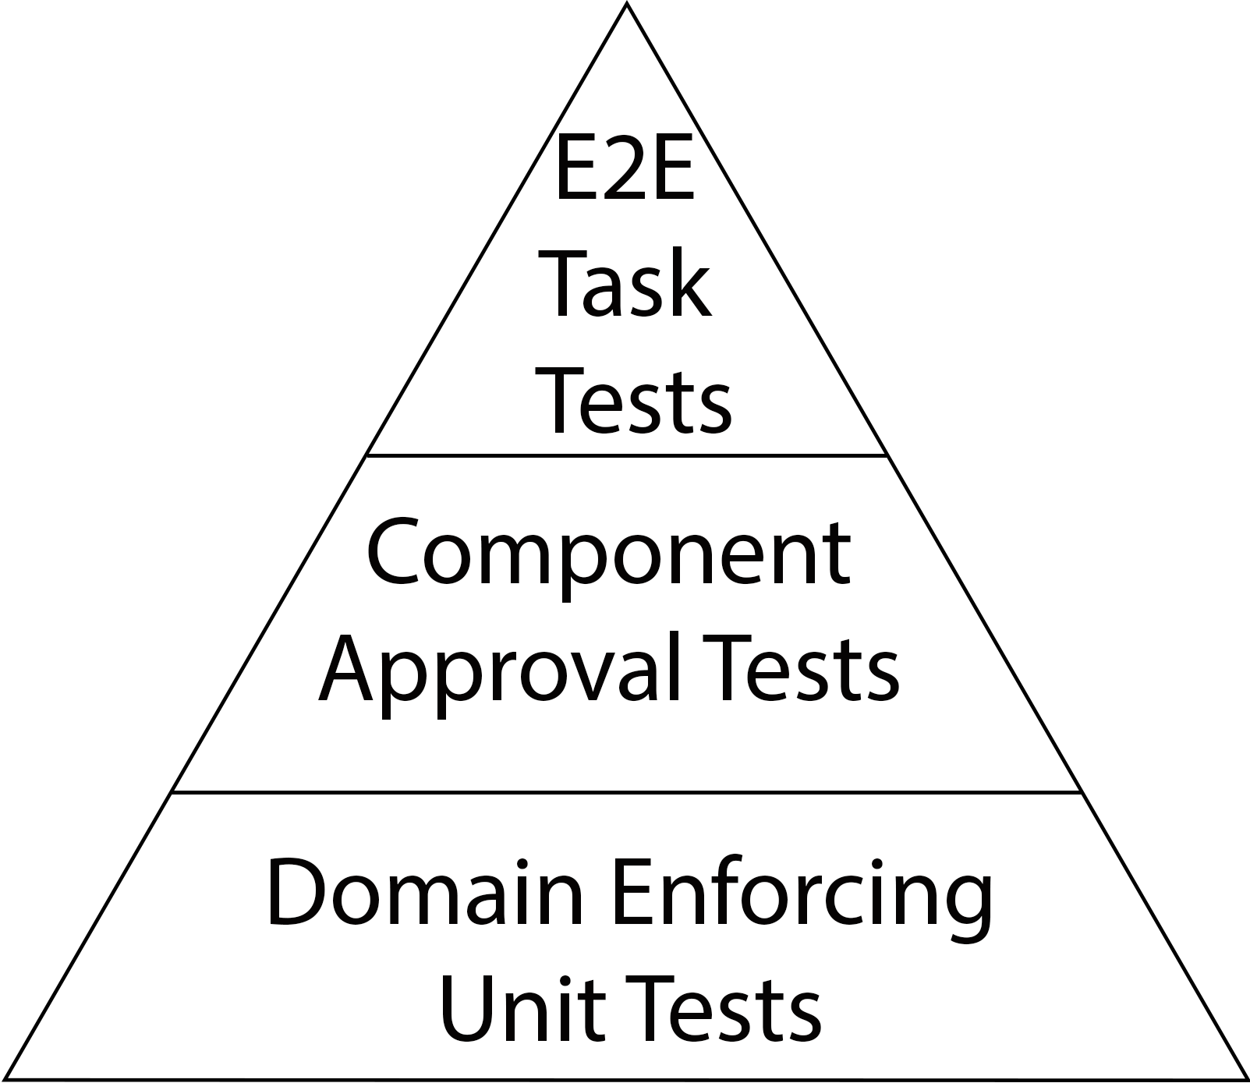
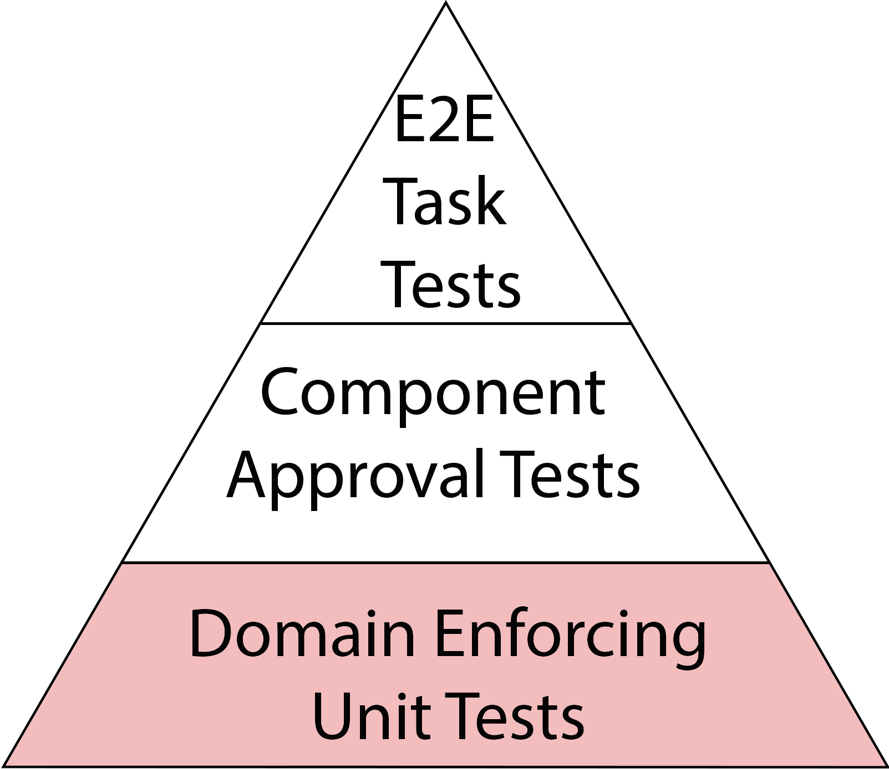
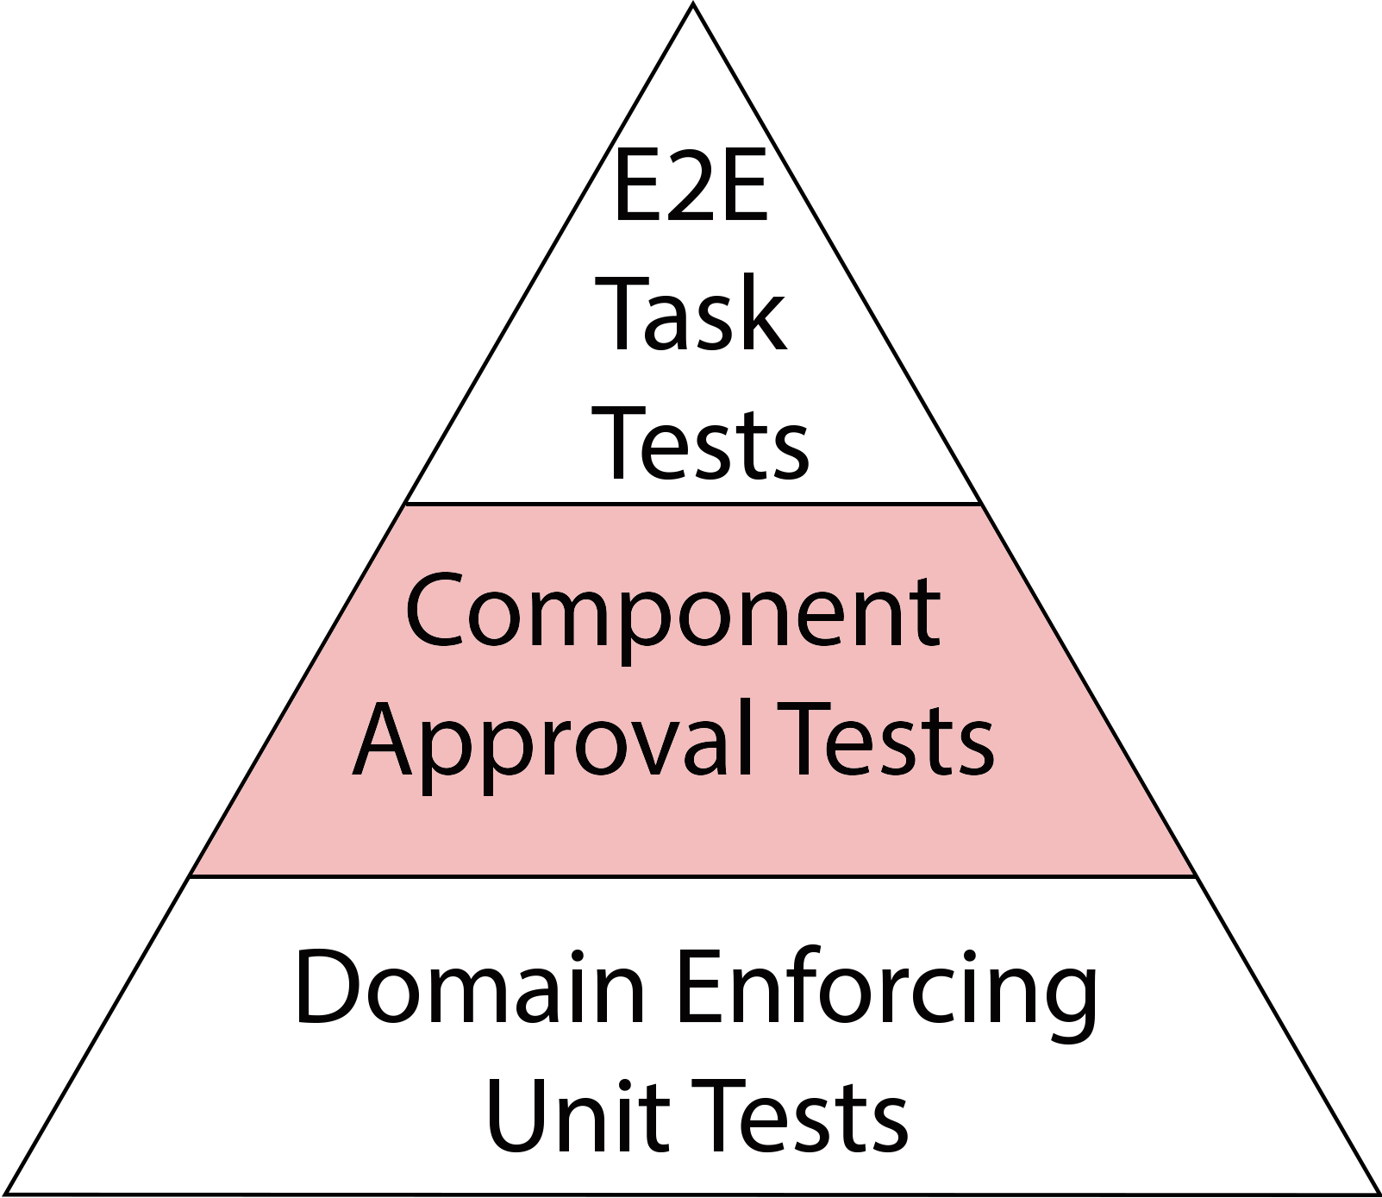
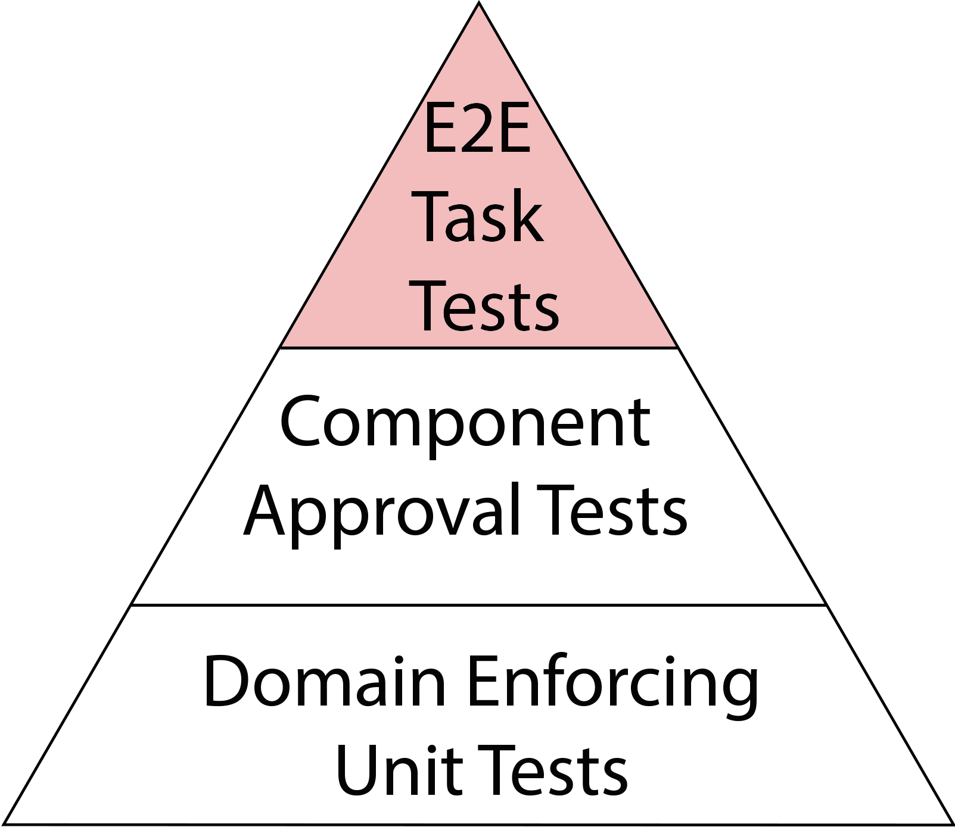
DDD Test Pyramid
↑ Fidelity
↓ Speed
↑ Cost
↓ Fidelity
↑ Speed
↓ Cost

Slide 52
Domain Enforcing
Unit Tests
Tests as Auditor
Last Day Style
Invariants Approval Testing

Slide 53
Approval Testing
What is
Approval Testing?
Evolving Validation
Requirements
Driven
↑ Fidelity
↑ Cost
Notes:
Bug is not a bug situation
Not upfront
Tackling blindness

Slide 54
Back to Domain Enforcing Unit Tests
Property Based Testing
QuickTheory
Invariants Approval Testing
Schema Based Testing
Schema Based Testing
JSON Schema Validator
JSON Schema Validator
Notes:
Design by Contract

Slide 55
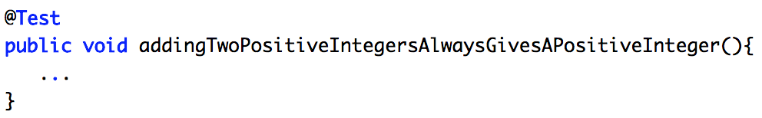
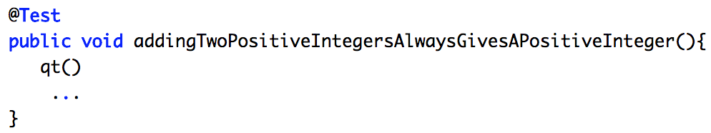
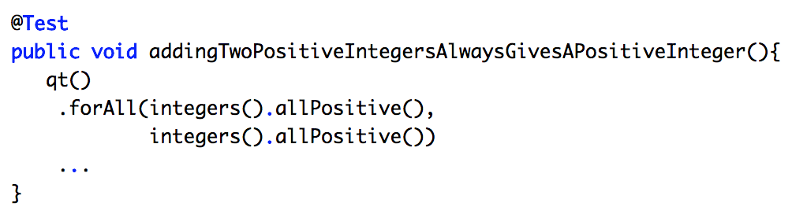
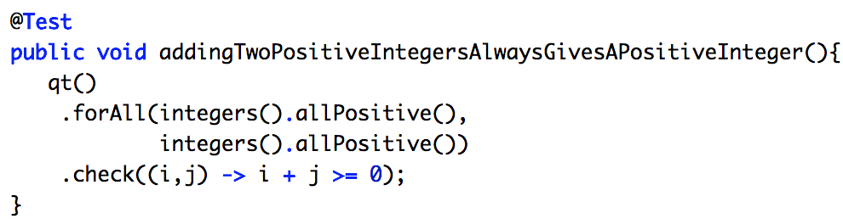
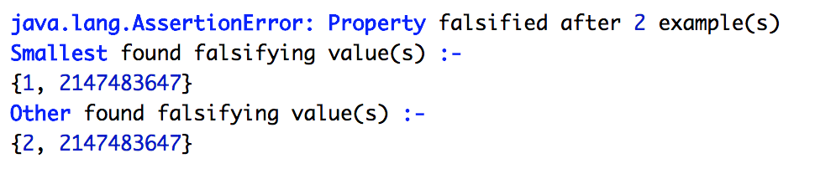
QuickTheory
Notes:
Text test
Diffy
Json schema validator

Slide 56
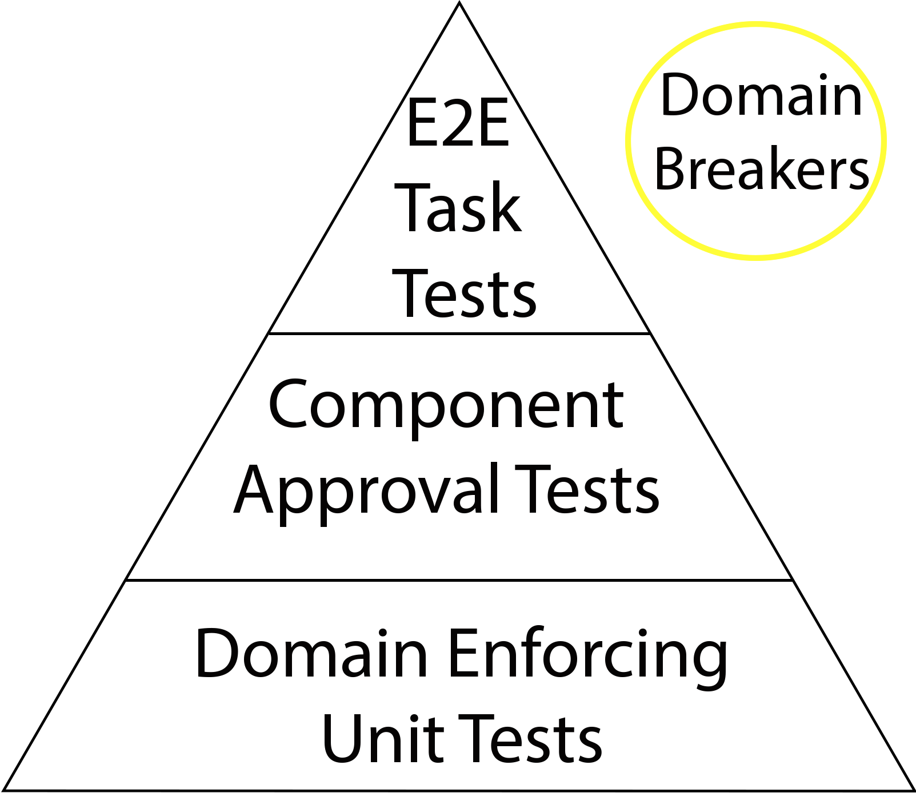
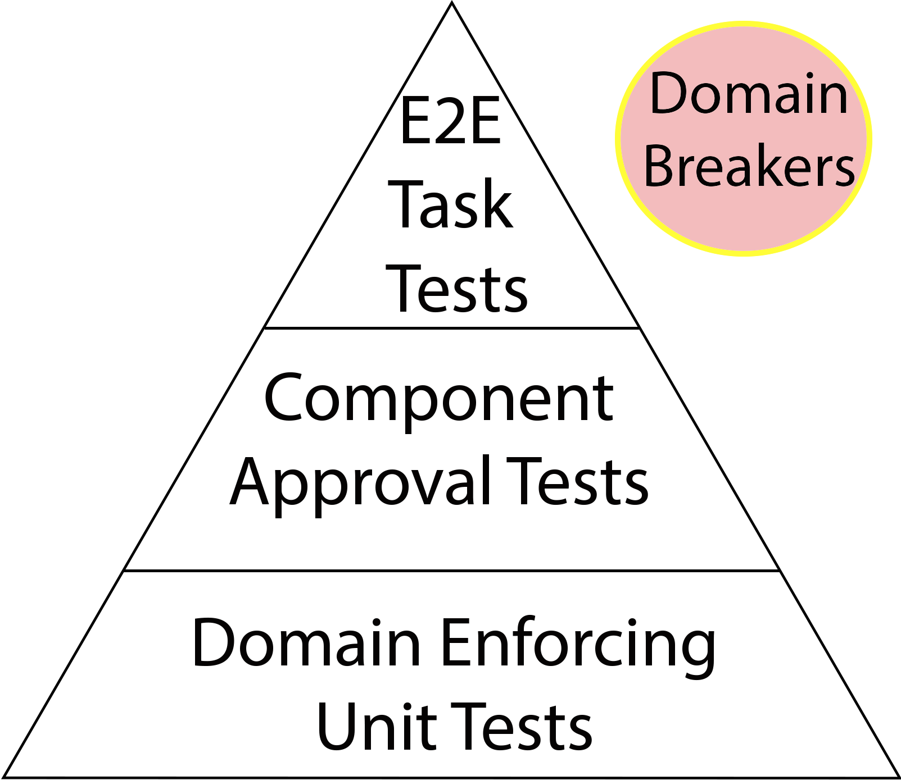
DDD Test Pyramid
↓ Fidelity
↑ Speed
↓ Cost
Notes:
Explain width is #tests
Think Acceptance Tests
!Exploratory tests under breaker

Slide 57
Component
Approval Testing
Text Based Testing
TextTest
TextTest
Snapshot Testing
Snapshot Testing
Jest
Jest
BackstopJS
Visual Testing
Visual Testing
Applitools

Slide 58
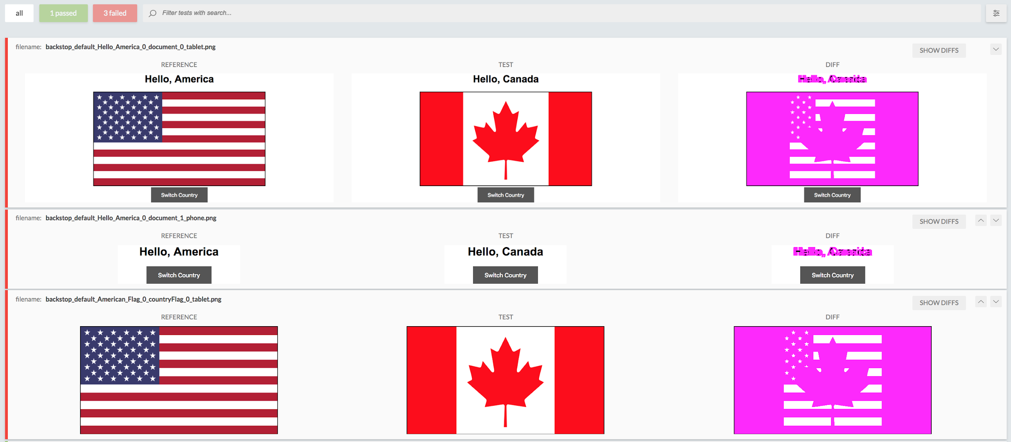
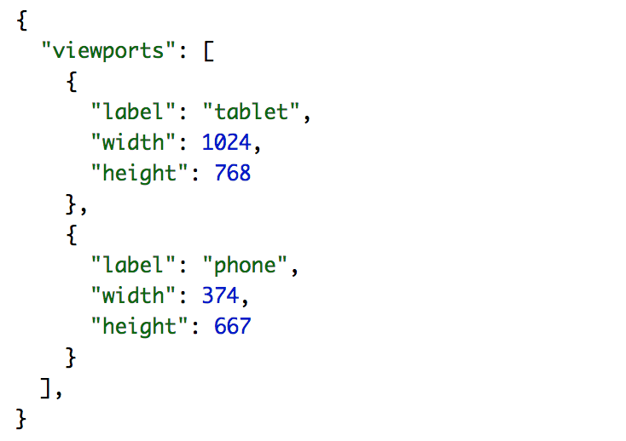
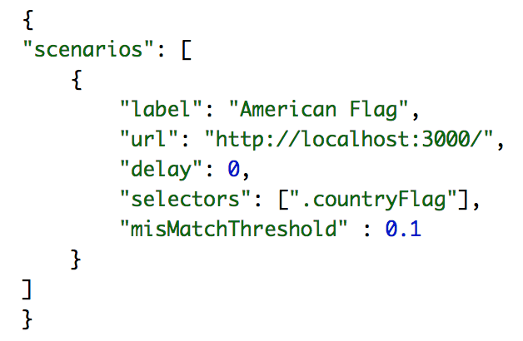
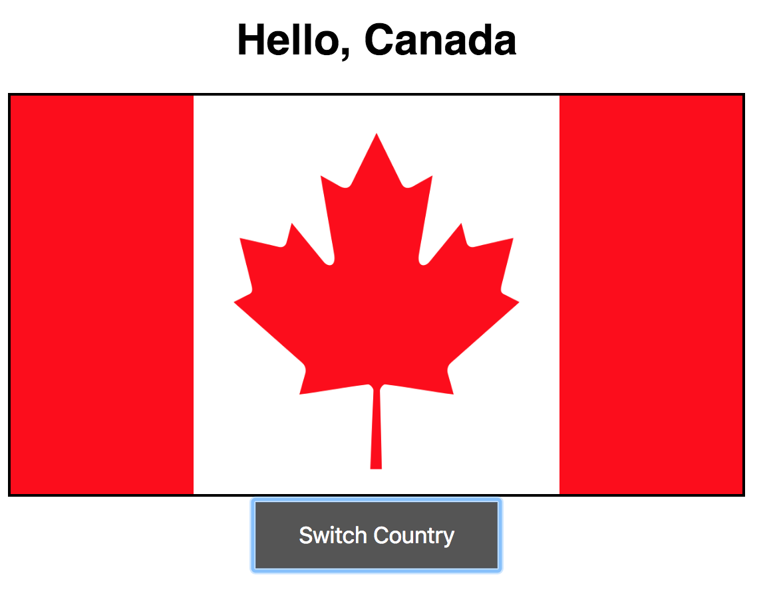
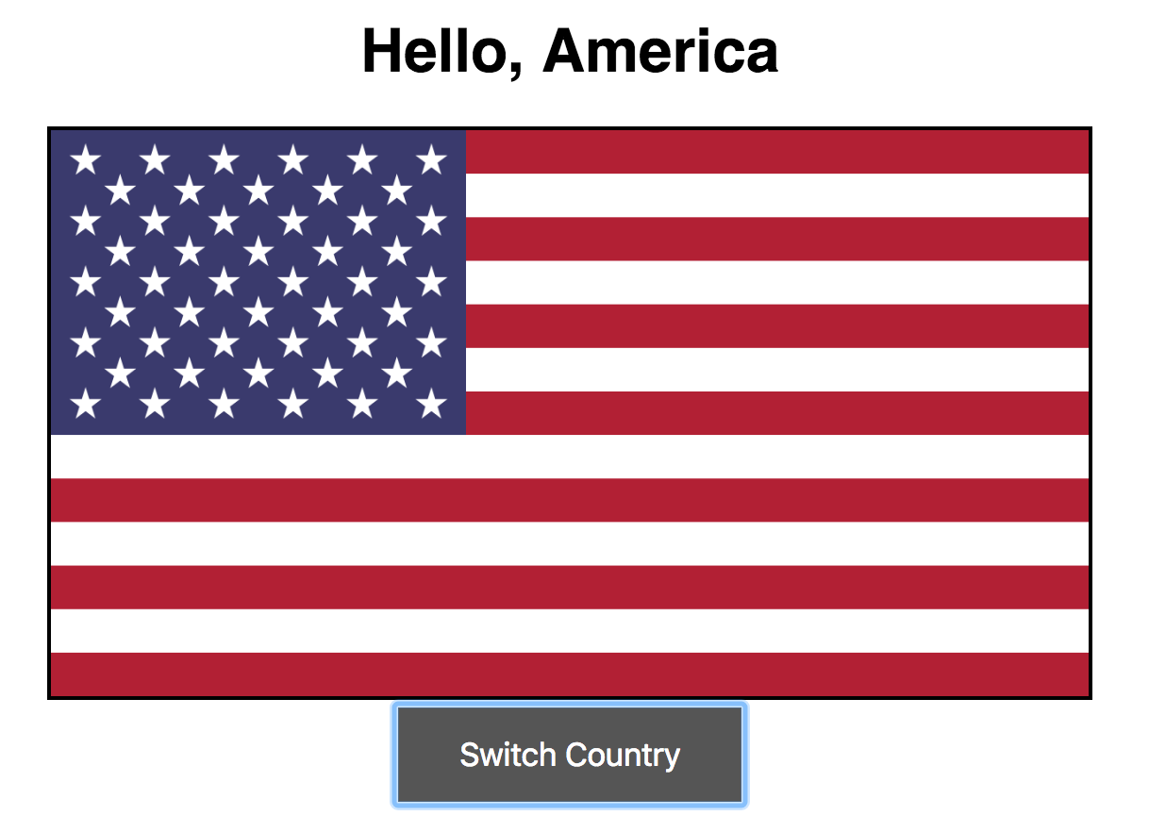
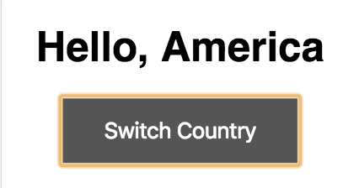
BackstopJS

Slide 59
DDD Test Pyramid
↑ Fidelity
↓ Speed
↑ Cost
↓ Fidelity
↑ Speed
↓ Cost
Notes:
Explain width is #tests
Think Acceptance Tests
!Exploratory tests under breaker

Slide 60
End-to-End Task Testing
User Centric Testing
Interactions
Tasks
Page Object Model
Screenplay Pattern
Notes:
Possibly talk about screenplay vs interation, explain why task
SOLID pattern

Slide 61
Focus on User Dimension
Conclusion

Slide 62
User Dimensions
Web User
Client Side
Protractor
API User
RestAssured
Server Side

Slide 63
DDD Test Pyramid
↑ Fidelity
↓ Speed
↑ Cost
↓ Fidelity
↑ Speed
↓ Cost
Notes:
Explain width is #tests
Think Acceptance Tests
!Exploratory tests under breaker

Slide 64
Agenda
Broken Code
Broken Team
Broken Team
Broken Team
Broken You
Broken You

Slide 65
Domain Driven Design
It is all about Communication
Notes:
Communication is essential in a team settings

Slide 66
Common Design Pitfalls
One Size Fits All
Dogmatism
No Design
Evolution
Design Stagnation
Notes:
One size fits all,

Slide 67
How to Tackle?
Domain Driven Design

Slide 68
Common Design Pitfalls
Domain Driven Design
One Size Fits All
One Size Fits All
One Size Fits All
Context Matters
Dogmatism
Dogmatism
Dogmatism
Design
Guidance
Design
Guidance
Design
Evolution
Design
Evolution
Design Lifetime
No Design
Evolution
Design Lifetime
No Design
Evolution
Design Stagnation
Design Stagnation
No Design
Evolution
Design Stagnation
Notes:
One size fits all,

Slide 69
Context Matters
Ubiquitous Language
Bound Context
Bound Context
Domain Segregation
Domain Segregation

Slide 70
Ubiquitous Language
Context Matters:
Ubiquitous Language
Engineers
Testers
Domain Experts
Notes:
Example???

Slide 71
Context Matters
Ubiquitous Language
Ubiquitous Language
Ubiquitous Language
Ubiquitous Language
Bound Context
Bound Context
Bound Context
Bound Context
Domain Segregation
Domain Segregation
Domain Segregation

Slide 72
Domain Driven Design
One Size Fits All
Dogmatism
One Size Fits All
Context Matters
Context Matters
Context Matters
Context Matters
One Size Fits All
Dogmatism
Dogmatism
Guidance
Design
Guidance
Design
Guidance
No Pattern
Evolution
No Pattern
Evolution
No Pattern
Evolution
Pattern
Evolution
Design
Evolution
No Expiry Date
No Expiry Date
No Expiry Date
Expiration Date
Design Lifetime
Notes:
One size fits all,

Slide 73
Design Guidance
Context Mapping
Minimalism
Minimalism
Design by Contract
Design by Contract
Notes:
Example???

Slide 74
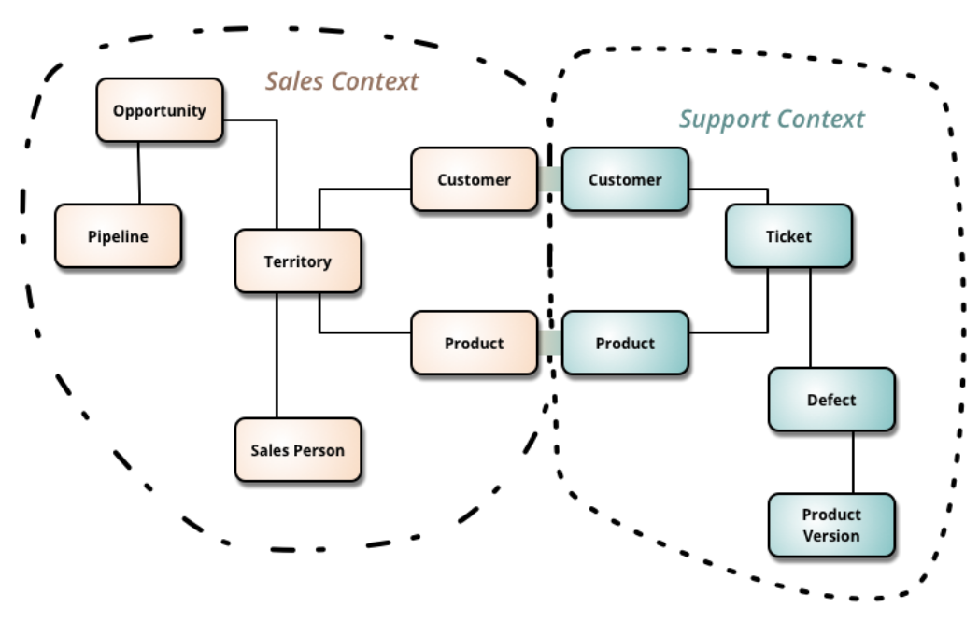
Context Map, Martin Fowler
https://martinfowler.com/bliki/BoundedContext.html
Context Map Example

Slide 75
Design Guidance:
Context Mapping
Documentation
Communication
Current State
Notes:
Design is the code, the code is design
Big ball of mud, make it visibl

Slide 76
Galactic Modeling Language
Box
Line
Label
Notes:
According to Kent Beck (http://wiki.c2.com/?GalacticModelingLanguage)

Slide 77
Context Map, Martin Fowler
https://martinfowler.com/bliki/BoundedContext.html
Context Map Example

Slide 78
Domain Driven Design
One Size Fits All
Dogmatism
One Size Fits All
Context Matters
Context Matters
Context Matters
Context Matters
One Size Fits All
Dogmatism
Dogmatism
Guidance
Guidance
Design
Guidance
Design Guidance
No Pattern
Evolution
No Pattern
Evolution
No Pattern
Evolution
Pattern
Evolution
Design
Evolution
Design
Evolution
No Expiry Date
No Expiry Date
No Expiry Date
Expiration Date
Design Lifetime
Notes:
Immutable

Slide 79
Design Evolution:
Strategic Decisions
Team Collaboration
Absorbing Feedback
Experience Diversity
Notes:
Working with Domain Experts, Testers, Developers
Really get and use the feedback from every stackholder
Try to have engineers of all levels, of all backgrounds

Slide 80
Domain Driven Design
One Size Fits All
Dogmatism
One Size Fits All
Context Matters
Context Matters
Context Matters
Context Matters
One Size Fits All
Dogmatism
Dogmatism
Guidance
Guidance
Guidance
Design
Guidance
No Pattern
Evolution
No Pattern
Evolution
Design
Evolution
No Pattern
Evolution
Pattern
Evolution
Design
Evolution
Design
Evolution
No Expiry Date
No Expiry Date
No Expiry Date
Expiration Date
Design Lifetime
Design Lifetime
Notes:
One size fits all,

Slide 81
Conclusion?
Communication is Essential in DDD
Notes:
Example???

Slide 82
What if we were to go beyond Design?

Slide 83
Project Planning
Low Hanging Fruits
Dogfooding
Parkinson’s Law
Conway’s Law
Notes:
These projects are unknown and ever harder to plan for
Dogfooding is the key
Know you your domain
Try other products in your area
Example: Wordpress, Squarespace, WIX
Parkinson’s Laws
“work expands so as to fill the time available for its completion”
Stop scope creep early, no benefit in it
Parkinson's law of triviality
Nuclear plant committee primarily focused on discussing what material bikeshedding should be made of
Conway’s Law
Your design will match your organization’s structure
Begin with the team

Slide 84
Regardless
Communication
is the Key

Slide 85
Communication
Reach Time
Synchronous
Response Time
Asynchronous
Setting Expectations
Names to Faces
Notes:
Always prefer asynchronous communication
Emergencies should be unique
Instant Messaging does not mean instant replies
Ignore but don`t forget
Make sure expectations are clear
Might expect to get a reply instantly or on Weekends
Note: the worst when you get email on weekend with “don’t bother to reply until Monday”
Lead by example and don`t reply
Note: France outlawed this behaviour
Put your face as an avatar so people still feel like they work with people (and use webcam when possible)

Slide 86
But
What about
Human Aspect?

Slide 87
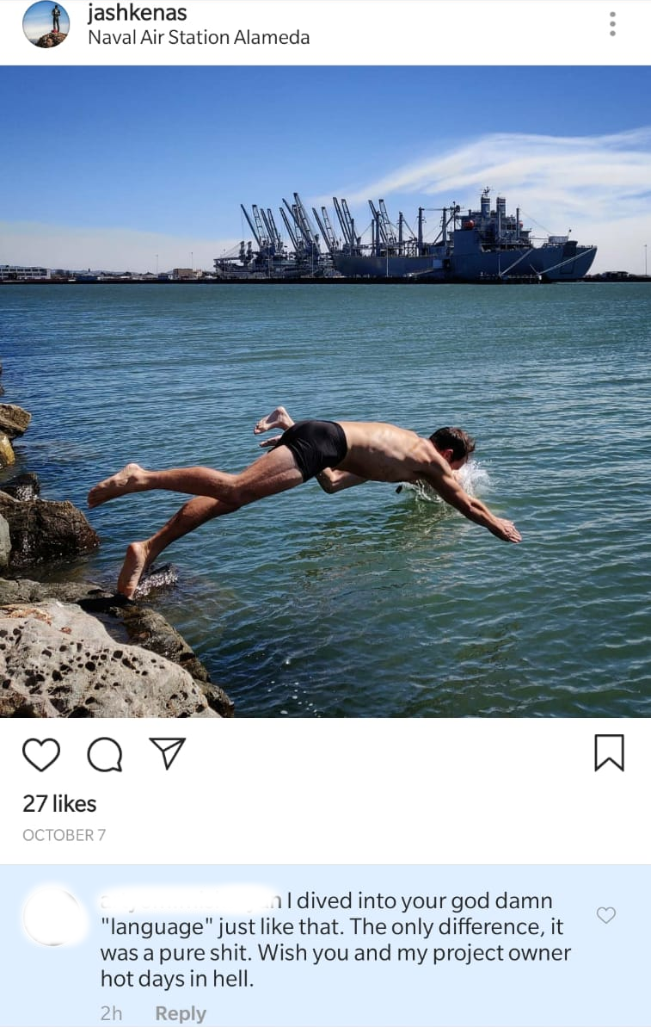
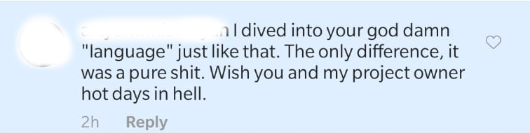
Jeremy Ashkenas, https://goo.gl/PeBRku
Notes:
Creator of CoffeeScript, Backbone.js, Underscore, etc.

Slide 88
Focus on Positive Emotions
No Reasons to be Rude
Art of Unsent Letters
Focus Improvements
Focus on Success
Proactive Feedback
Notes:
Never a good reason to be rude - no benefit
Angry letter
Abraham Lincoln used to write letters when angry but never send them
Not always need for a rush for constant improvements - stop and appreciate what was done
Share proactive, positive feedback
Tell them (juniors) that they have a talent
Example
Coby O'Brien and his father story - 11 years old, zero points, got positive feedback has been working ever since

Slide 89
Talk Suggestions
Brett Cannon on Kindness
Changelog Episode
Notes:
Book Link: https://www.amazon.com/Power-Habit-What-Life-Business/dp/081298160X

Slide 90
That’s all great
But how do we deal with our Work Environment?

Slide 91
Office and You
Open Office
Office Perks
Office Bribes
Work on Plane
Work is just Work
Notes:
Open office is nightmare
Otherwise, people would not have been looking for ways to find privacy, quite space, etc.
People (primarily, managers) end up using meeting rooms as their offices
Interestingly, I found some salespeople like it more
Don`t fall for Office perks
Example: Dinner for staying late
It is a bribe
Work is a balance where you trade your life energy (your time) for money
DHH - Work takes, Life gives
Work on Plane dilemma
We get more work done on a plane or in a cafe rather than on our workplaces
Consider remote work
Work is just work
Don’t make it about status, friends, “family”
Can do it on your own time

Slide 92

Book Suggestion
Notes:
Book Link: https://www.amazon.com/Remote-Office-Required-Jason-Fried/dp/0804137501

Slide 93
The main grievance
Distractions
Notes:
There is a reason why most work is done in a coffee place

Slide 94
Distractions
Mobile Devices
Noise Control
Noise Control
Setting Boundaries
Setting Boundaries
Getting into Zone
Getting into Zone
Notes:
Mobile devices can be useful
but also can be time waster and stress source
Noise control in the office settings full of stressors
Controlling your environment
Getting into focused state

Slide 95
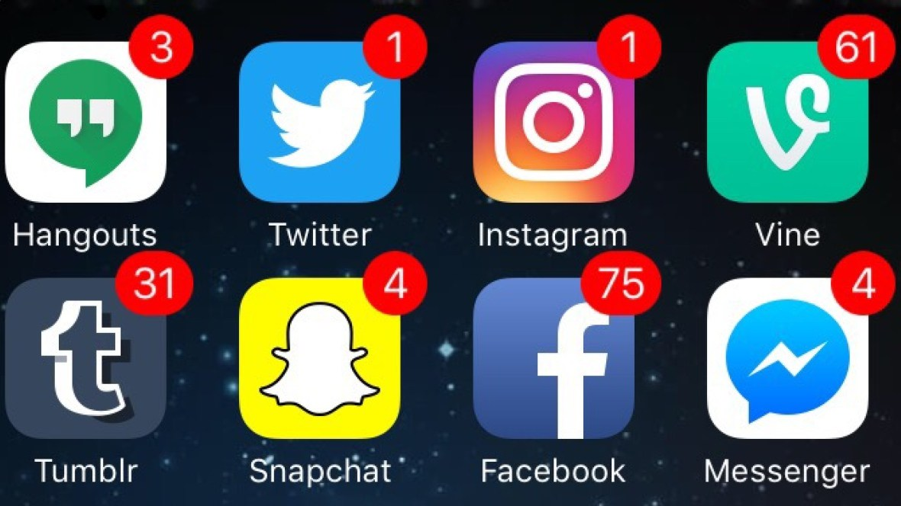
Before:
Notes:
References: https://my-thai.org/two-minutes-just-quickly-checking-ig/

Slide 96
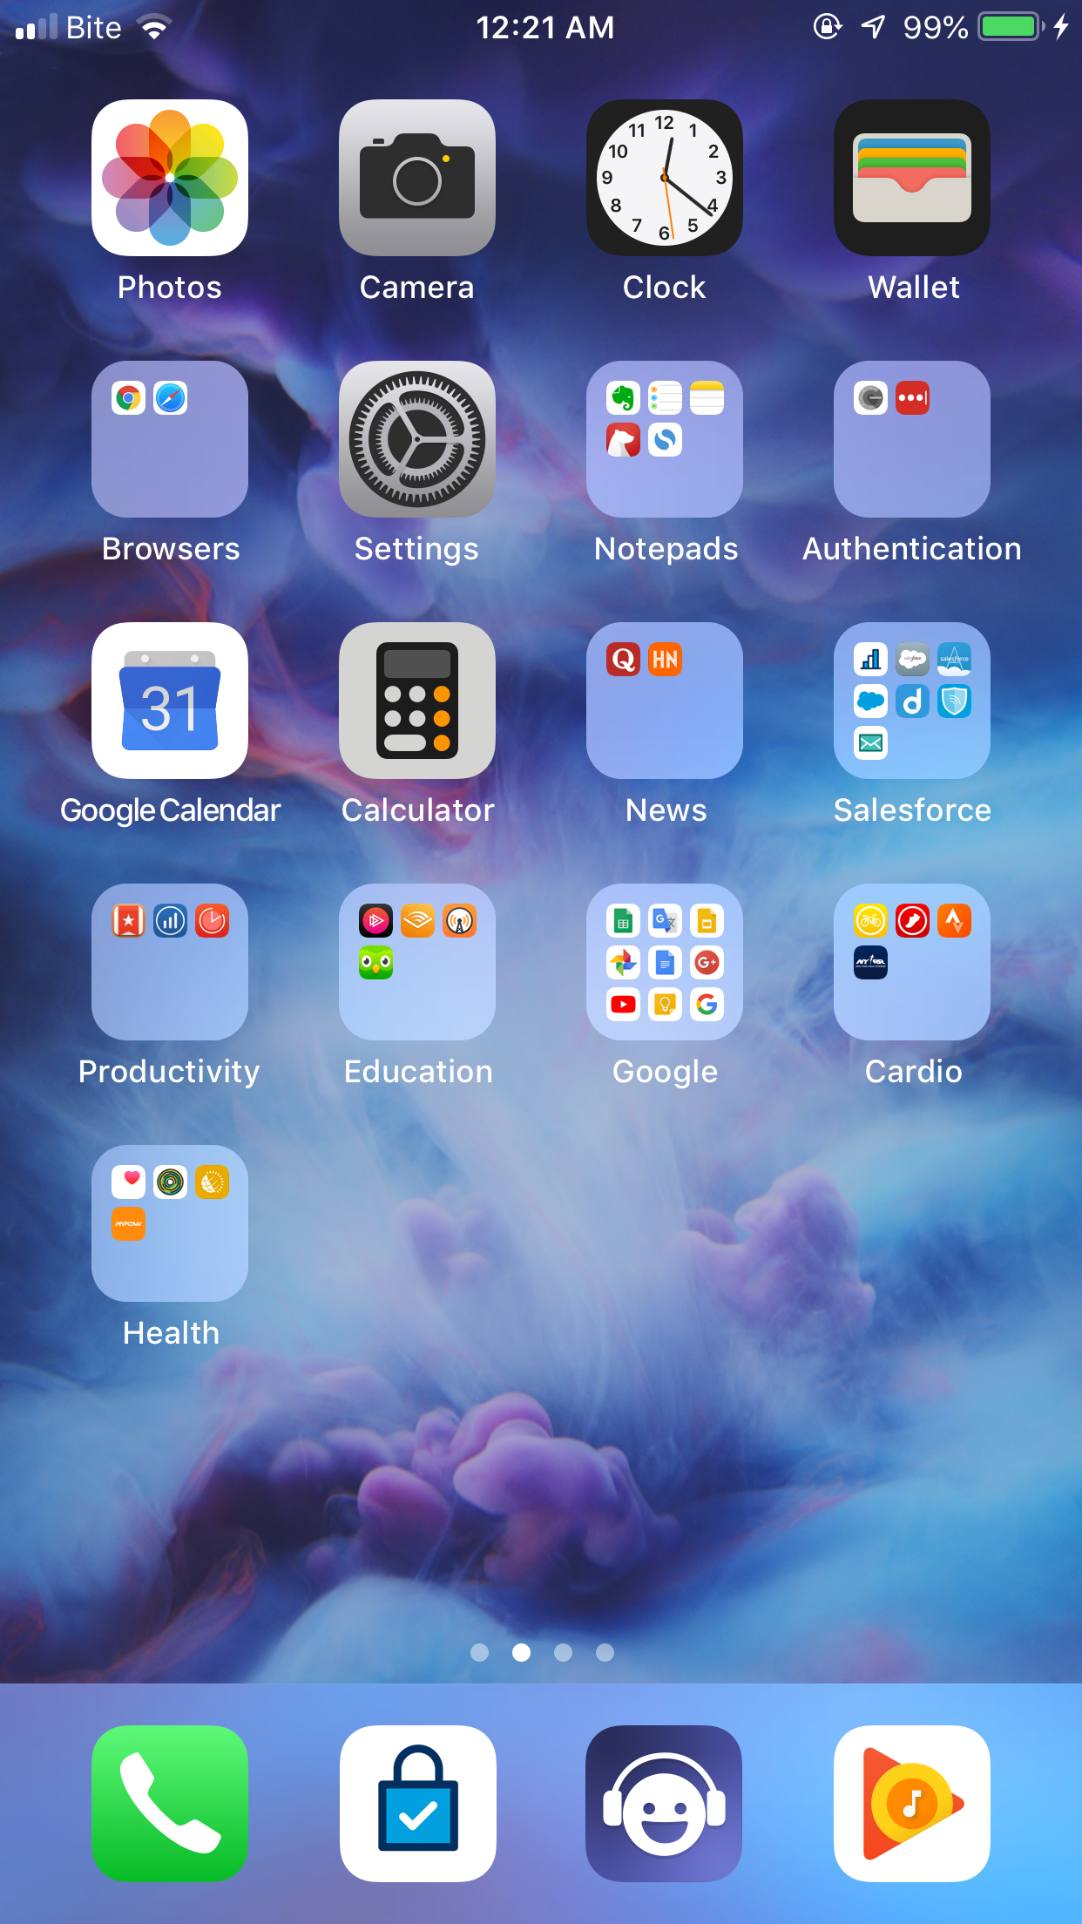
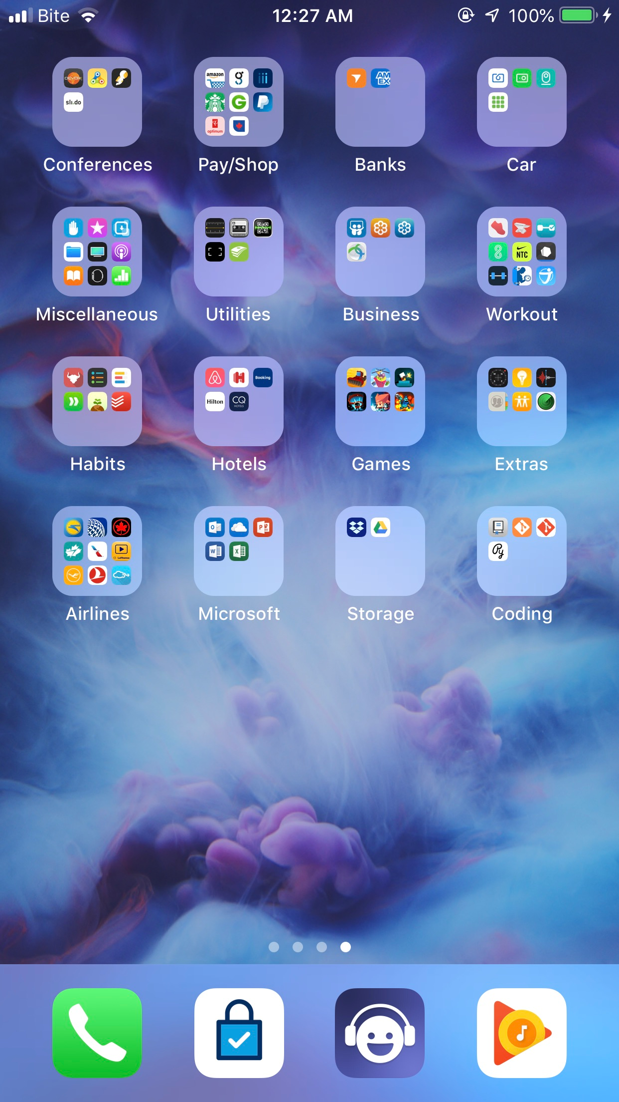
After:
Notes:
Note:
No Notification popups
All messaging apps are moved away from easy access
Apps are grouped
Reference: My Phone

Slide 97
Mobile Devices
Arrange Apps
Disable Notifications
Don’t Disturb Mode
Put Phone Away
Notes:
Potentially even delete apps
Move messaging to the next screen
No notifications
Disable corporate account (at least after work)
Don`t Disturb Mode always on
Who calls these days anyways?
My phone number is online and the phone calls I get from scammers on taxes
Put your phone arm length away from you - makes a huge difference

Slide 98
Distractions
Mobile Devices
Mobile Devices
Noise Control
Noise Control
Noise Control
Setting Boundaries
Setting Boundaries
Getting into Zone
Getting into Zone

Slide 99
Noise Control
Meaningless Noise
Sound Support
Notes:
Benefits
studies shown that sitting in a cafe, people can focus more
it is all about the noise being meaningless to us
Sound Support

Slide 100
Apps Suggestions
Brain.fm
Spotify
MyNoise
Notes:
Headspace is especially great to get started

Slide 101
Noise Control
Meaningless Noise
Sound Support
Noise Cancellation

Slide 102
Solutions Suggestions
Ear Plugs
Earmuffs
Noise Cancelling Headphones
Notes:
Headspace is especially great to get started

Slide 103
Noise Control
Meaningless Noise
Sound Support
Noise Cancellation
Library Rules

Slide 104
Library Rules
Keep Quiet
Async
Ping First
Establish Office Hours
Discuss the Rules
Notes:
If need to discuss something, go to the room
Ping someone before interrupting them
Crucial for experts to have office hours like in academia
Make sure everyone agrees on what rules you want to follow as a team

Slide 105
Agenda
Broken Code
Broken Team
Broken Team
Broken Team
Broken You
Broken You
Broken You

Slide 106
Stress
Why would we talk about it?

Slide 107
Let’s look externally first

Slide 108
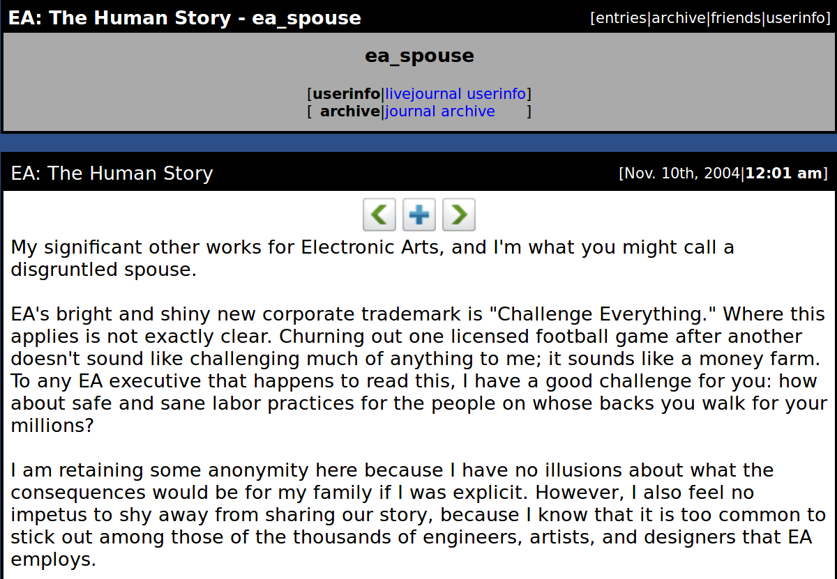
@ea_spouse, https://goo.gl/eQBYxh

Slide 109
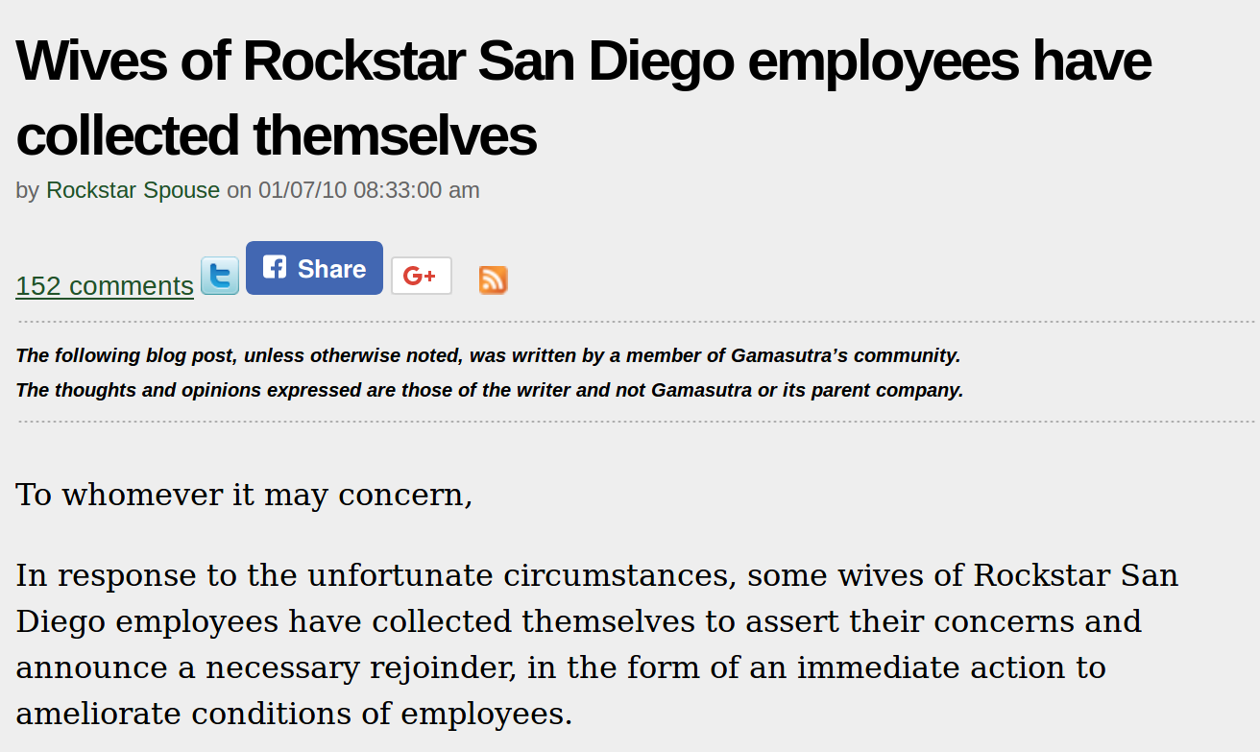
Rockstar Spouse, https://goo.gl/2sqyhh

Slide 110
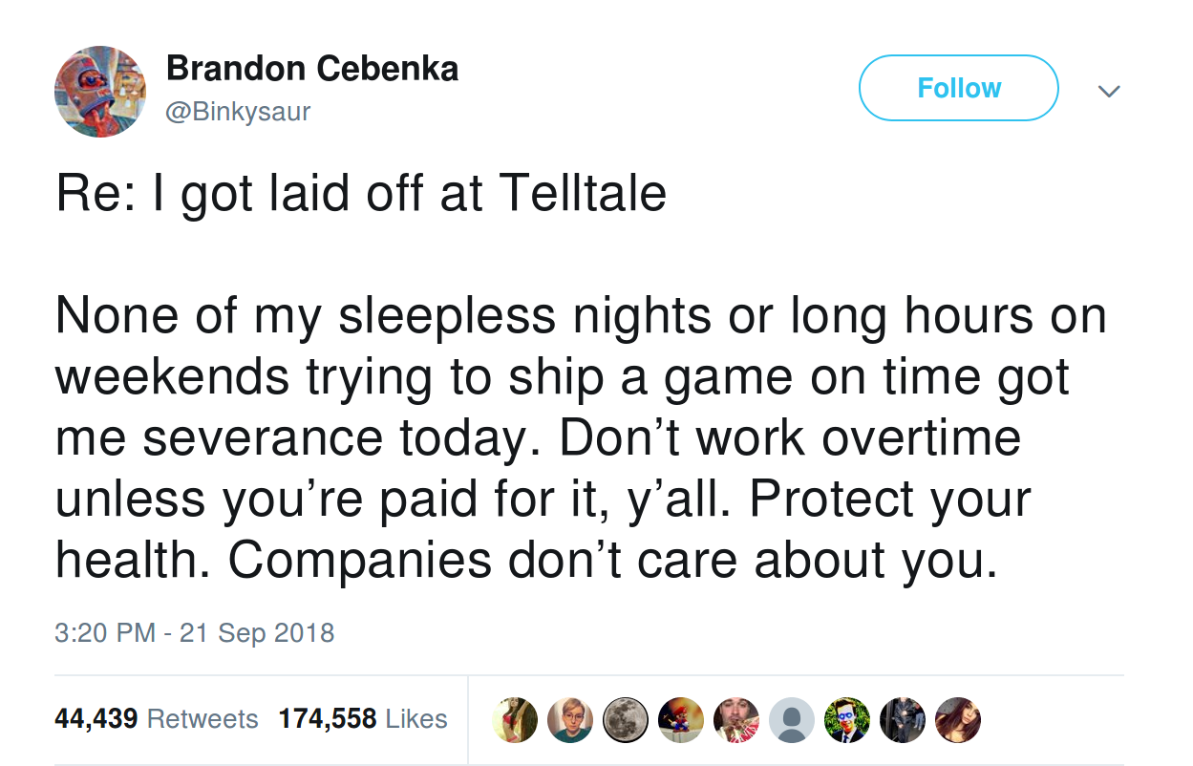
@Binkysaur, https://goo.gl/h9TQad

Slide 111
There are many more cases
Externally
Internally too?

Slide 112
What about
your colleagues?
your family?
you?

Slide 113
Nature is smart
Purpose of Stress
Fight
Flight
Sleep
Hunger
Notes:
Nature is smart -> No reason to leave something if unnecessary
Goals of Stress:
Fight or Flight response
Sleep deprivation -> long hunts, trailing an animal
Hunger -> body stores energy during diets and when we were unsuccessful hunters

Slide 114
If Stress makes sense...
Why do I feel so bad?
Notes:
If it is so inherently good, why does it feel bad to be stressed?
Why do I get unwanted weight, insomnia, anger issues, etc.

Slide 115
Types of Stress
Short-Term
Long-Term
Notes:
Short Term:
Acute stress
Heat shock (sauna and cold shower)
Long Term:
Long state of distress
Body energy is exhausted

Slide 116
Conclusion?
Incorporate
Short-Term Stress
Eliminate
Long-Term Stress

Slide 117
Let’s talk about
Mental Fitness
Notes:
See my talk on more information

Slide 118
Mental Fitness
Mindfulness
Clearing Your Mind
Embracing Solitude
Embracing Solitude
Incorporating Meditation
Incorporating Meditation
Notes:
Mindfulness
Being present in the moment
Personal
Couldn`t understand it - felt somewhat elitist
Until I was finishing off my run and one of the audiobooks I was listening to defined Mindfulness for me again
Running exhausted me, so I was able to concentrate

Slide 119
Clear Mind
Information Overload
Information Dump
Source of Truth
Single Focus
Notes:
Too much information
Don`t simply have hundreds of notes in your house
Organize them into a single source of truth (app that you will use)
Evernote

Slide 120

Book Suggestion
Notes:
Book Link: https://www.amazon.com/Subtle-Art-Not-Giving-Counterintuitive/dp/0062457713

Slide 121
Mindfulness
Clearing Your Mind
Clearing Your Mind
Embracing Solitude
Embracing Solitude
Embracing Solitude
Incorporating Meditation
Incorporating Meditation

Slide 122
Art of Solitude
Quiet Moments
Float Therapy
Learn About Yourself
Clear Judgements
Notes:
Going to nature
Remove headphones
Float Therapy
Sensory deprivation capsule
90 minutes
Understanding yourself and appreciating yourself
Remove fears of staying alone (or without a job) -> removes stress and lets to make clear judgements

Slide 123
Mindfulness
Clearing Your Mind
Clearing Your Mind
Embracing Solitude
Embracing Solitude
Embracing Solitude
Embracing Solitude
Incorporating Meditation
Incorporating Meditation
Incorporating Meditation

Slide 124
Meditation
Unguided Meditation
Guided Meditation
Active Meditation
Consistency is Key
Notes:
Unguided Meditation
Great to get into zone without distraction
Guided Meditation
Best place to start
Active Meditation
Staying in the moment when working out
Consistency
10 minutes is not too much
Tony Robbins, “If you don`t have 10 minutes for yourself, you don`t have life”

Slide 125
Need help to get started?
Notes:
Doesn`t have anything to do with religion

Slide 126
Apps Suggestions
Headspace
Relax Meditation
Calm
Notes:
Headspace is especially great to get started

Slide 127
Sceptical of Meditation?
Notes:
Doesn`t have anything to do with religion

Slide 128
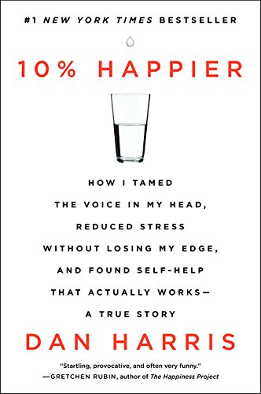
Book Suggestion
Notes:
Book Link: https://www.amazon.com/10-Happier-Self-Help-Actually-Works/dp/0062265431

Slide 129
More Sources
of Work Stress
Long Hours
Productivity &
Effectiveness

Slide 130
Overwork/Long Hours
Creatures of Habit
Unreasonable Expectations
150% + 50%
100% + 100%
Major Regret
Notes:
If we work long hours, we will keep doing it
Especially consultants, hard to know when the day stops and where it starts
Establish boundaries
Expectations should be very clear
with you team
with your boss
with your family
You are not isolated
Simple math
Overworking is the major regret and here is a reference

Slide 131

Book Suggestion
Notes:
Book Link: https://www.amazon.com/Top-Five-Regrets-Dying-Transformed/dp/140194065X

Slide 132
More Sources
of Work Stress
Long Hours
Long Hours
Productivity &
Effectiveness
Productivity &
Effectiveness
Productivity &
Effectiveness

Slide 133
Productivity & Effectiveness
Split Hours
Unused Benefits
60 x 1
15 x 4
Lost Passion
Challenge Yourself
Notes:
Simple math
Protect your time, keep yourself focused
Unused benefits
Unlimited vacation
Not actually limited
Take what you used to + 1 day
Education funds
VTOs
Share your passion with family and friends
meetups
DevoxxKids
Challenge yourself
No reason to leave, maybe transfer
Try new tool/framework

Slide 134
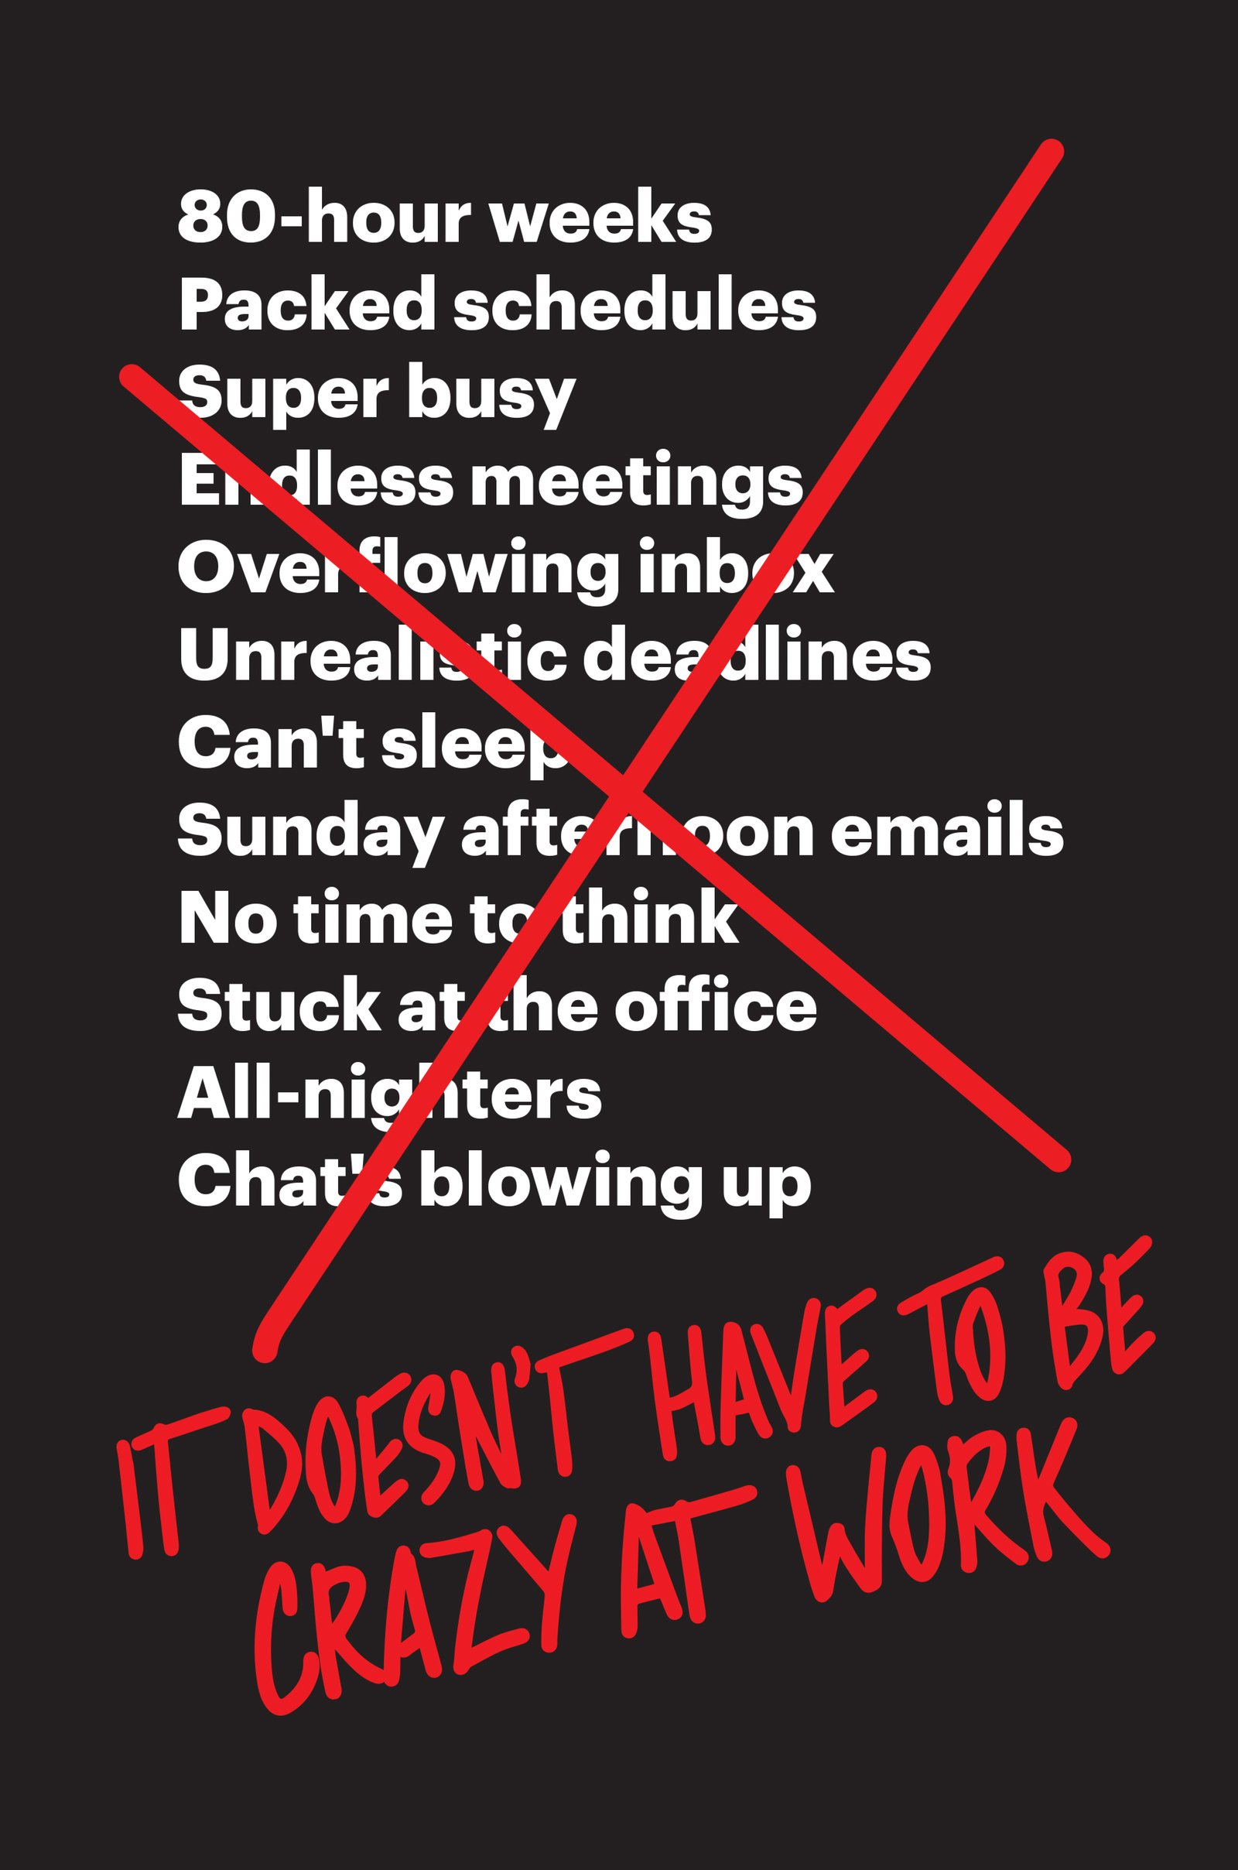
Book Suggestion
Notes:
Book Link: https://www.amazon.com/Doesnt-Have-Be-Crazy-Work/dp/0062874780

Slide 135
Are there any gotchas?
Yes, there are

Slide 136
Receipts for Failure
Dogmatism
Jumping Too Fast
Not Having Goals
Fighting Your Nature
Notes:
Following diets and practices by the book is never a good idea - in life, at work, or anywhere else
Overdoing it is a bad idea
Analogy: running marathon without training
will complete, but will not be able to do anything for days
You need to have goals to succeed (simpler the better)
Don`t fight your nature, work with it
remember Habits Loop

Slide 137

Book Suggestion
Notes:
Book Link: https://www.amazon.com/Own-Day-Your-Life-Optimized/dp/0062684078

Slide 138
There is so much information
Who do we trust?
Notes:
Why should you even trust me?

Slide 139
Recommendations
Find Specialist
Talk to Professional
Experiment
Share your Experience
Notes:
Find someone you can trust (someone who resonates with you and your style)
Example: I trust Ben Greenfield, and if I search for “Are nuts healthy” I would include his name in the search query
Do blood work, talk to professional
Experiment with different foods and see what works for you
Share your experience - there are many people like you, and they would want to learn from and with you

Slide 140
To that last point of sharing
What makes them stick
Skipped major part of habits

Slide 141
Beliefs
Find Inspiration
Find Purpose
Find Community
Notes:
I was lucky to have a colleague of mine who inspired me to actually try to change my habits
I hope to inspire some of you as well
Mentioned purpose and goals before
Even pairs will be enough
go to meetup, run after work, etc.
References back to the idea of motivators

Slide 142
Call For Action
Welcome Change
Lead by Example
Communicate
Experiment!
Notes:
Repair Broken Windows

Slide 143
Q/A

Slide 144
About Speaker
Twitter: @DmitryVinnik
LinkedIn: in/dmitry-vinnik/
Email: dmitry@dvinnik.com

